Slide 1
Planning in the Continuous Domain: a Generalized
Belief Space Approach for Autonomous Navigation in
Unknown Environments
Vadim Indelman, Luca Carlone , and Frank Dellaert
International Journal of Robotics Research - 2015
Indelman, V., Carlone, L., and Dellaert, F. (2013). Towards planning in generalized belief space. In Proc. of the Intl. Symp. of Robotics Research (ISRR).
Indelman, V., Carlone, L., and Dellaert, F. (2014). Planning under uncertainty in the continuous domain: a generalized belief space approach. In IEEE Intl. Conf. on Robotics and Automation (ICRA).
Dan and Alon

Slide 2
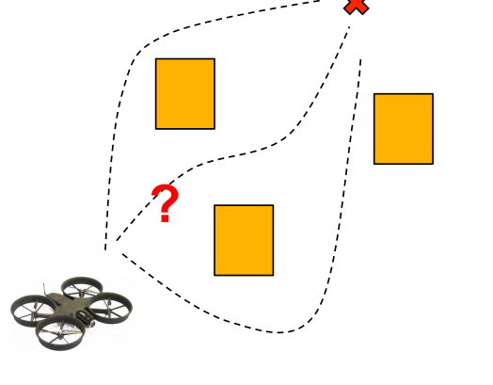
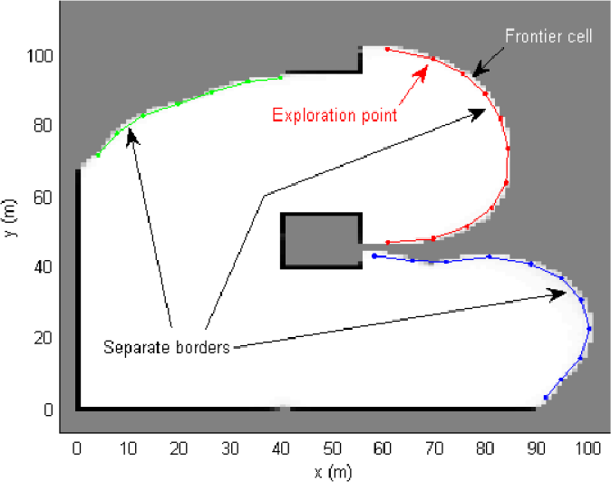
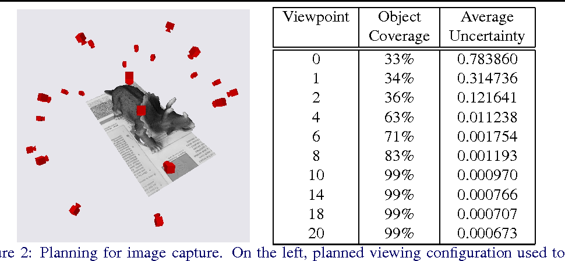
Problem Statement
Formulate a general strategy to accomplish common tasks in robotics in the following setting:
No prior knowledge
Continuous Domain (as opposed to discrete)
Maximum Likelihood Observations
Path Planning
Exploration
Next Best View

Slide 3
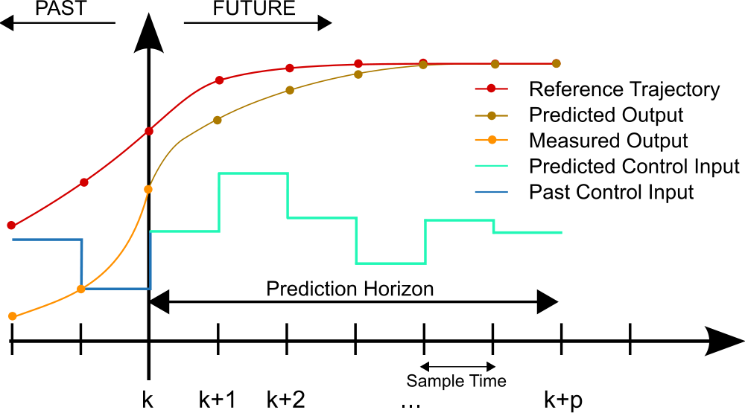
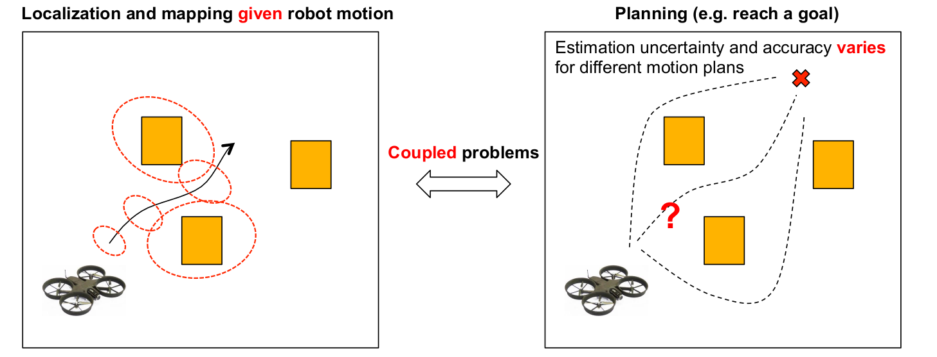
Approach:
Model Predictive Controller
Plan with the Estimation in mind – Reason about future observations

Slide 4
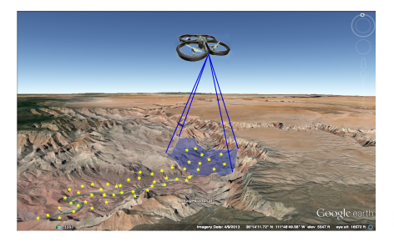
Motivating Example Used:
UAV flies over an unknown region with a camera looking downwards.
Its goal is to reach pre-specified goal positions while preserving an acceptable localization error
Notes:
UAV in an unknown

Slide 5
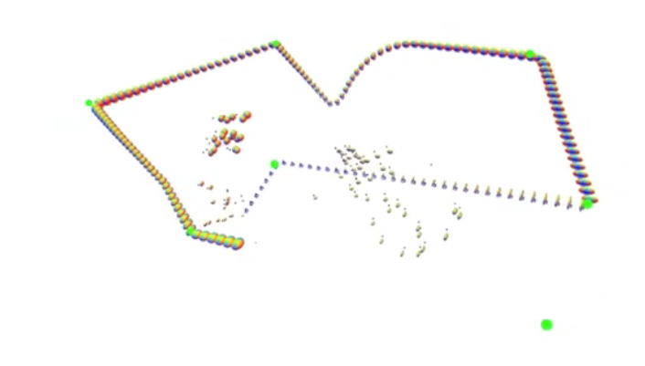

Slide 6
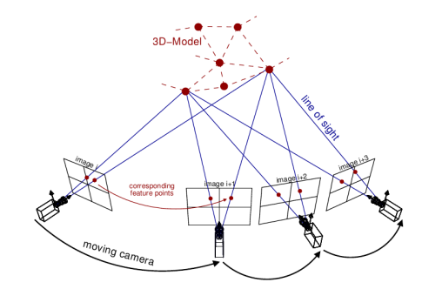
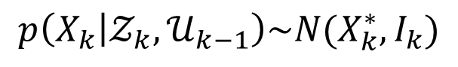
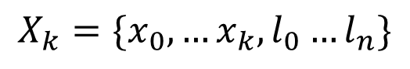
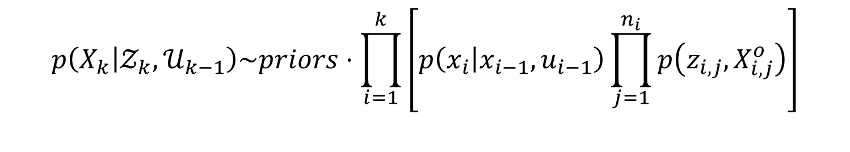
Plan with Estimation in Mind:
As the environment is unknown, a joint state vector is held:
$$X_{k}=\{x_{0},…x_{k},l_{0}…l_{n}\}$$
robot poses
landmarks
Estimation over the joint probability:
$$p\left(X_{k} | 𝒵_{k},𝒰_{k−1}\right)\sim priors⋅\prod_{i=1}^{k}{\left[p\left(x_{i} | x_{i−1},u_{i−1}\right)\prod_{j=1}^{n_{i}}{p\left(z_{i,j},X_{i,j}^{o}\right)}\right]}$$
Motion model
Observation model
Architect models such that the posterior can be modeled as a gaussian:
$$p\left(X_{k} | 𝒵_{k},𝒰_{k−1}\right)\sim N(X_{k}^{∗},I_{k})$$
Information Matrix

Slide 7
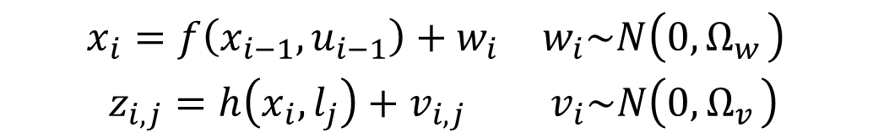
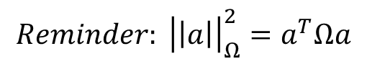
Solving for the posterior distribution via Expectation Maximization:
$$X_{k}^{∗}=\underset{X_{k}}{argmax} p\left(X_{k} | 𝒵_{k},𝒰_{k−1}\right)=\underset{X_{k}}{argmin}\left\{−\log\left(p\left(X_{k} | 𝒵_{k},𝒰_{k−1}\right)\right)\right\}$$
$$\begin{matrix}x_{i}=f\left(x_{i−1},u_{i−1}\right)+w_{i} & w_{i}\sim N\left(0,Ω_{w_{ }}\right) \\ z_{i,j}=h\left(x_{i},l_{j}\right)+v_{i,j} & v_{i}\sim N\left(0,Ω_{v_{ }}\right)\end{matrix}$$
$$X_{K}^{∗}=\underset{X_{k}}{argmin} \left\{{\left|\left|x−{\hat{x}}_{0}\right|\right|}_{Ω_{0}}^{2}+\sum_{i}{\left[{\left|\left|x_{i}−f\left(x_{i−1},u_{i−1}\right)\right|\right|}_{{Ω_{w}}_{i}}^{2}+\sum_{j=ℳ_{i}}{{\left|\left|z_{i,j}−h\left(x_{i},l_{j}\right)\right|\right|}_{{Ω_{v}}_{i,j}}^{2}}\right] }\right\}$$
Prior
Motion Models
Observation models
$$Reminder: {\left|\left|a\right|\right|}_{Ω}^{2}=a^{T}Ωa$$

Slide 8

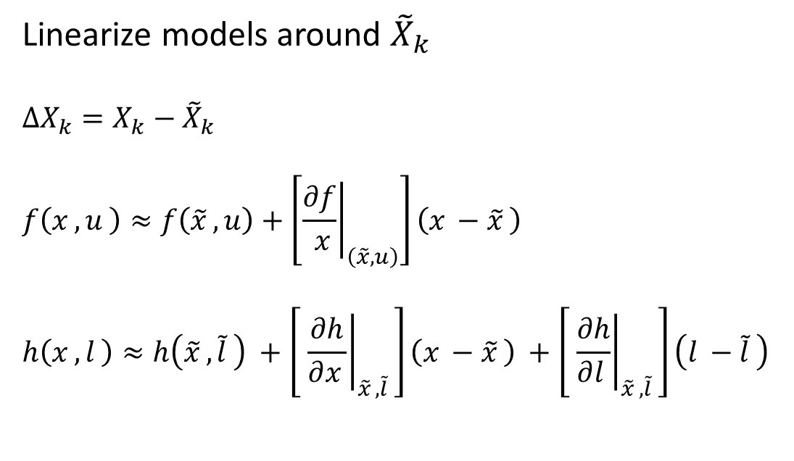
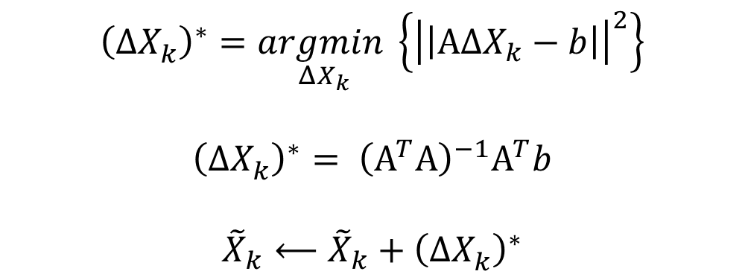
Solving for the posterior distribution via Expectation Maximization:
$$X_{K}^{∗}=\underset{X_{k}}{argmin} \left\{{\left|\left|x−{\hat{x}}_{0}\right|\right|}_{Ω_{0}}^{2}+\sum_{i}{\left[{\left|\left|x_{i}−f\left(x_{i−1},u_{i−1}\right)\right|\right|}_{{Ω_{w}}_{i}}^{2}+\sum_{j=ℳ_{i}}{{\left|\left|z_{i,j}−h\left(x_{i},l_{j}\right)\right|\right|}_{{Ω_{v}}_{i,j}}^{2}}\right] }\right\}$$
Linearize models around ${\tilde{X}}_{k}$
$$ΔX_{k}=X_{k}−{\tilde{X}}_{k}$$
$$f\left(x_{ },u_{ }\right)≈f\left({\tilde{x}}_{ },u\right)+\left[{\left.\frac{∂f}{ x}\right|}_{\left(\tilde{x}, u\right)}\right]\left(x_{ }−{\tilde{x}}_{ }\right)$$
$$h\left(x_{ },l_{ }\right)≈h\left({\tilde{x}}_{ },{\tilde{l}}_{ }\right) +\left[ {\left.\frac{∂h}{∂x_{ }}\right|}_{{\tilde{x}}_{ },{\tilde{l}}_{ }}\right]\left(x_{ }−{\tilde{x}}_{ }\right) +\left[ {\left.\frac{∂h}{∂l_{ }}\right|}_{{\tilde{x}}_{ },{\tilde{l}}_{ }}\right]\left(l_{ }−{\tilde{l}}_{ }\right)$$
$${\left(ΔX_{k}^{ }\right)}^{∗}=\underset{ΔX_{k}}{argmin}\left\{{\left|\left|ΑΔX_{k}−b\right|\right|}^{2}\right\}$$
$${\left(ΔX_{k}^{ }\right)}^{∗}= {\left(Α^{T}Α\right)}^{−1}Α^{T}b$$
$${\tilde{X}}_{k}⟵{\tilde{X}}_{k}+{\left(ΔX_{k}^{ }\right)}^{∗}$$
Do this until convergence

Slide 9
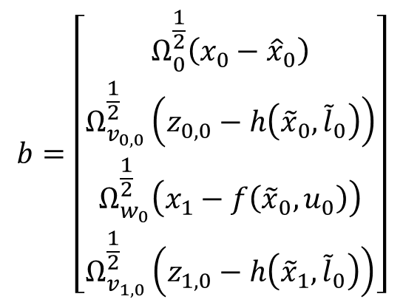
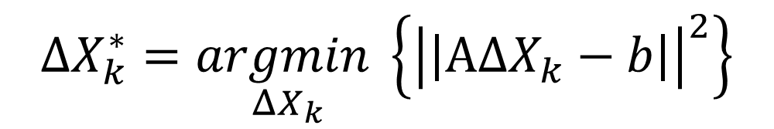
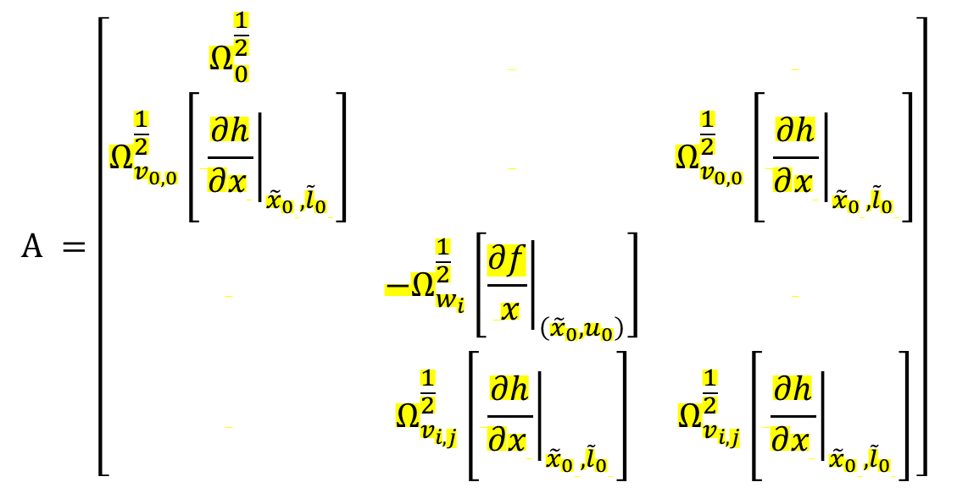
Solving for the posterior distribution via Expectation Maximization:
$$ΔX_{k}^{∗}=\underset{ΔX_{k}}{argmin}\left\{{\left|\left|ΑΔX_{k}−b\right|\right|}^{2}\right\}$$
$$Α =\left[\begin{matrix}Ω_{0}^{\frac{1}{2}} & & \\ Ω_{v_{0,0}}^{\frac{1}{2}}\left[ {\left.\frac{∂h}{∂x_{ }}\right|}_{{{\tilde{x}}_{0}}_{ },{{\tilde{l}}_{0}}_{ }}\right] & & Ω_{v_{0,0}}^{\frac{1}{2}}\left[ {\left.\frac{∂h}{∂x_{ }}\right|}_{{{\tilde{x}}_{0}}_{ },{{\tilde{l}}_{0}}_{ }}\right] \\ & −Ω_{w_{i}}^{\frac{1}{2}}\left[{\left.\frac{∂f}{ x}\right|}_{\left({\tilde{x}}_{0}, u_{0}\right)}\right] & \\ & Ω_{v_{i,j}}^{\frac{1}{2}}\left[ {\left.\frac{∂h}{∂x_{ }}\right|}_{{{\tilde{x}}_{0}}_{ },{{\tilde{l}}_{0}}_{ }}\right] & Ω_{v_{i,j}}^{\frac{1}{2}}\left[ {\left.\frac{∂h}{∂x_{ }}\right|}_{{{\tilde{x}}_{0}}_{ },{{\tilde{l}}_{0}}_{ }}\right]\end{matrix}\right]$$
$$b=\left[\begin{matrix}Ω_{0}^{\frac{1}{2}}\left(x_{0}−{\hat{x}}_{0}\right) \\ Ω_{v_{0,0}}^{\frac{1}{2}}\left(z_{0,0}−h\left({\tilde{x}}_{0},{\tilde{l}}_{0}\right)\right) \\ Ω_{w_{0}}^{\frac{1}{2}}\left(x_{1}−f\left({\tilde{x}}_{0},u_{0}\right)\right) \\ Ω_{v_{1,0}}^{\frac{1}{2}}\left(z_{1,0}−h\left({\tilde{x}}_{1},{\tilde{l}}_{0}\right)\right)\end{matrix}\right]$$
Whitened errors
Whitened Jacobians
Not a function of the measurements (at first iteration)

Slide 10
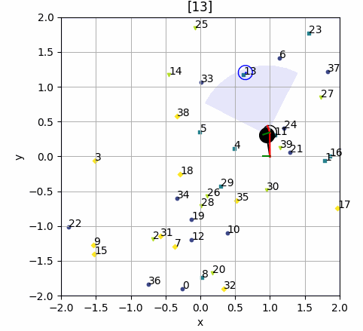
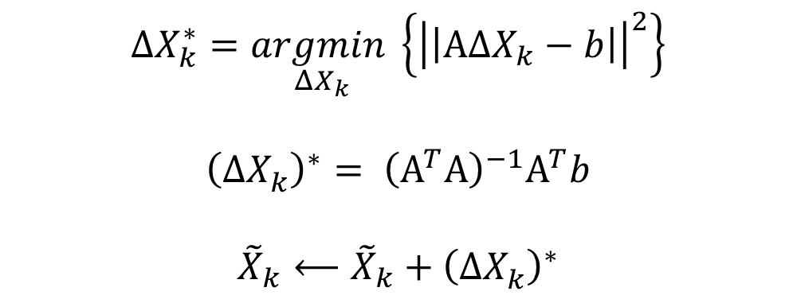
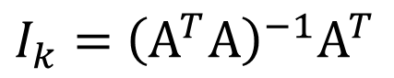
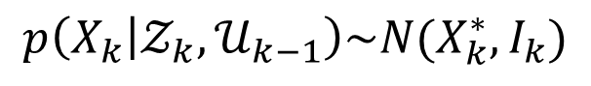
Solving for the posterior distribution via Expectation Maximization:
$$p\left(X_{k} | 𝒵_{k},𝒰_{k−1}\right)\sim N(X_{k}^{∗},I_{k})$$
$$ΔX_{k}^{∗}=\underset{ΔX_{k}}{argmin}\left\{{\left|\left|ΑΔX_{k}−b\right|\right|}^{2}\right\}$$
$${\left(ΔX_{k}^{ }\right)}^{∗}= {\left(Α^{T}Α\right)}^{−1}Α^{T}b$$
$${\tilde{X}}_{k}⟵{\tilde{X}}_{k}+{\left(ΔX_{k}^{ }\right)}^{∗}$$
$I_{k}=$ ${\left(Α^{T}Α\right)}^{−1}Α^{T}$
Do this until convergence

Slide 11
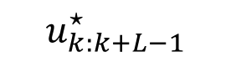
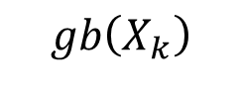
Planning in the Generalized Belief Space
$$gb\left(X_{k}\right)$$
Estimate of future state
$$u_{k:k+L−1}^{⋆}$$
$$gb\left(X_{k}\right)= p\left(X_{k} | 𝒵_{k},𝒰_{k−1}\right)\sim N(X_{k}^{∗},I_{k})$$

Slide 12
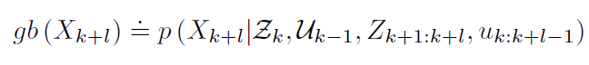
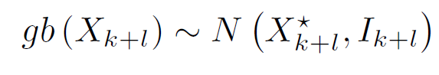
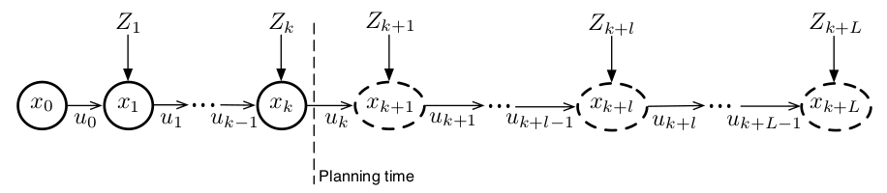
Planning in the Generalized Belief Space
Past
Future

Slide 13
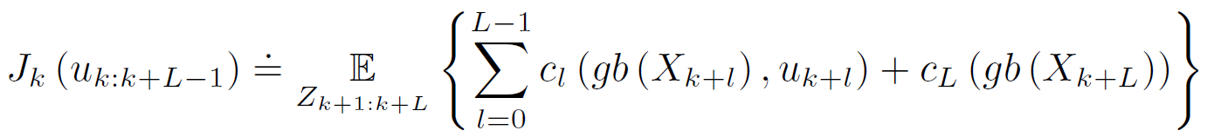
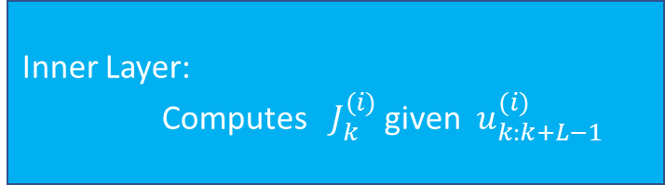

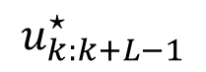
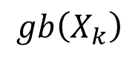
Planning in the Generalized Belief Space
Do this until convergence
Outer Layer: Updates $u_{k:k+L−1}^{(i+1)}$ given $J_{k}^{(i)}$
Inner Layer:
Computes $J_{k}^{(i)}$ given $u_{k:k+L−1}^{(i)}$
$$u_{k:k+L−1}^{⋆}$$
$$gb\left(X_{k}\right)$$
Notes:
Continuous Action Space:
The machine does not involve searching over the action space, but optimizing over it

Slide 14
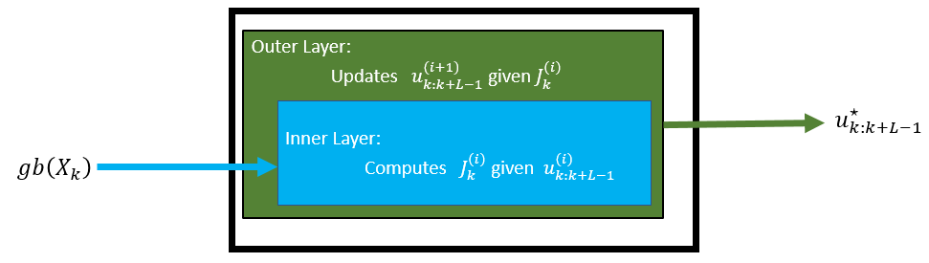
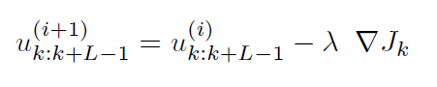
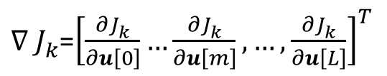

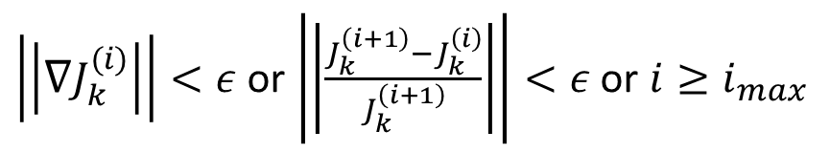
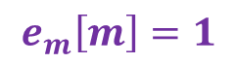
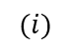
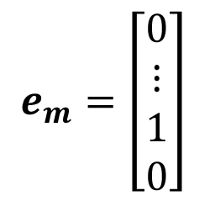
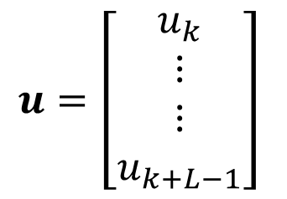
Outer Layer – Inference over the control
Updating via Gradient Decent:
$$(i)$$
Convergence Criteria:
$\left|\left|∇J_{k}^{(i)}\right|\right|<ε$ or $\left|\left|\frac{J_{k}^{\left(i+1\right)}−J_{k}^{\left(i\right)}}{J_{k}^{\left(i+1\right)}}\right|\right|<ε$ or $i≥i_{max}$
Discrete Gradient Computation:
$$\frac{{∂J}_{k}^{ }}{∂u[m]}≈\frac{J_{k}^{ }\left(u+ε⋅e_{m}\right)−J_{k}^{ }\left(u\right)}{ε}$$
$$u=\left[\begin{matrix}u_{k} \\ ⋮ \\ ⋮ \\ u_{k+L−1}\end{matrix}\right]$$
$$e_{m}=\left[\begin{matrix}0 \\ ⋮ \\ 1 \\ 0\end{matrix}\right]$$
$$e_{m}\left[m\right]=1$$
${∇_{ }J}_{k}^{ }$=${\left[\frac{{∂J}_{k}^{ }}{∂u\left[0\right]}…\frac{{∂J}_{k}^{ }}{∂u\left[m\right]},…,\frac{{∂J}_{k}^{ }}{∂u\left[L\right]}\right]}^{T}$
Notes:
(1) The control update is preformed in a continuous domain and can be realized using different optimization techniques. In the paper the method that used is a simple gradient method to compute $u_{k:k+L−1}^{⋆}$.

Slide 15
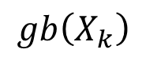

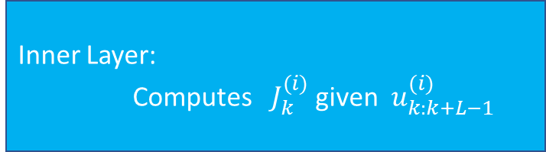
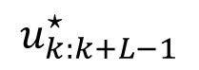
Inner Layer – Inference in GBS
Outer Layer: Updates $u_{k:k+L−1}^{(i+1)}$ given $J_{k}^{(i)}$
Inner Layer:
Computes $J_{k}^{(i)}$ given $u_{k:k+L−1}^{(i)}$
$$u_{k:k+L−1}^{⋆}$$
$$gb\left(X_{k}\right)$$
Past
Future
Notes:
We Now know how to update u from J
No we need to learn how to compute J from u

Slide 16
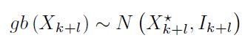

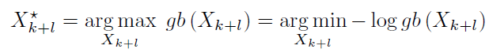
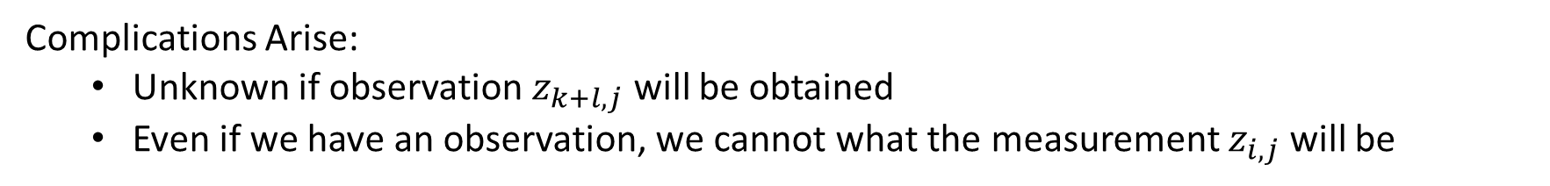

Inner Layer – Inference in GBS
To compute $J_{k}$ we need to infer in the future:
Expectation Maximization
Complications Arise:
Unknown if observation $z_{k+l,j}$ will be obtained
Even if we have an observation, we cannot what the measurement $z_{i,j}$ will be
Notes:
The inner layer involve the computation of the Gaussian approximation of:
Whose mean value coincides with the MAP estimate of:

Slide 17
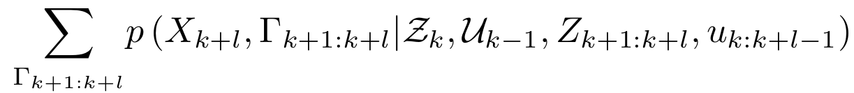
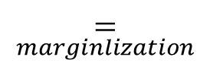
Inner Layer – Inference in GBS
$$\underset{marginlization}{=}$$
Binary variable for each future observation (Acquired/Not Acquired)
Expectation Maximization
$$X_{k+l}^{⋆}=\underset{X_{k+l}}{argmin} \{−\log\left(gb\left(X_{k+l}\right)\right\}=\underset{X_{k+l}}{argmin} \left\{−\log\left(\sum_{Γ_{k+1:k+l}}{p\left(X_{k+l},Γ_{k+1:k+l}|Z_{k},U_{k−1},Z_{k−1:k+l},u_{k:k+l−1}\right)}\right)\right\}$$
(*Minka,1998)
Notes:
Minka 1998 promises that this EM convergences to a local minimum of the cost

Slide 18
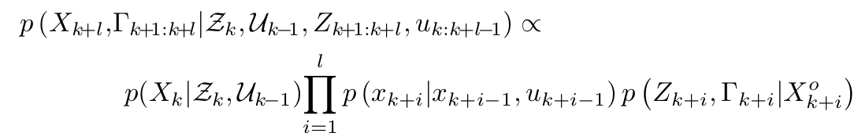
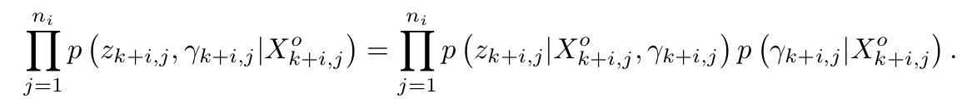
Inner Layer – Inference in GBS
Prior
Motion model
Observation models
Conditioning
Notes:
Finish slide with saying that we need to plug in the models and then we get -> next slide

Slide 19
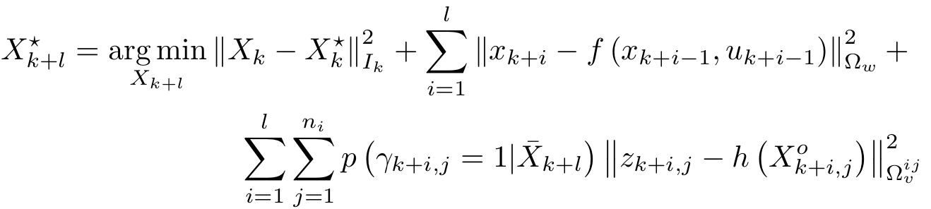


Inner Layer – Inference in GBS

Slide 20





Inner Layer – Inference in GBS
$$X_{k}^{⋆}$$
$${\overline{x}}_{k+1}$$
$${\overline{x}}_{k+2}$$
$${\overline{I}}_{k+l}$$
Also serves as linearization point
Notes:
If “solving” EM without future measurements, we can find I_kpl_Bar

Slide 21


Slide 22

A specific Family of Objective Functions
Penalizes last pose uncertainty
penalizes control effort
Penalizes last pose distance from goal
Penalizes last pose uncertainty
$M_{u},M_{Σ},M_{x}$ - Weight Matrices
$E_{k+L}^{G}, M_{Σ}$ - Selection Matrices

Slide 23


A specific Family of Objective Functions
Not a function of measurements
Not a function measurements under 1 Newton-Gauss Iteration
From term $\underset{Z_{k+1:k+L}}{𝔼}{\left|\left|E_{k+L}^{G}X_{k+L}^{⋆}−X^{G}\right|\right|}_{M_{x}}^{2}$

Slide 24



A specific Family of Objective Functions
Falls if assuming maximum likelihood measurements (proof in appendix)
Contains the matrix $I_{k+L}^{−1}$ which stems from EM with future measurements
$→$ Rewards loop closures

Slide 25



Choice of $M_{u}$
Larger $M_{u}$ minimizes control efforts.
smaller control efforts $→$ less torque applied to turn
Notes:
The lar

Slide 26





Choice of $M_{x}$ and $M_{Σ}$
Selection Matrix
Selection Matrix

Slide 27



Choice of $M_{x}$ and $M_{Σ}$
$α_{k}$ can’t be bigger than 1

Slide 28




Choice of $M_{x}$ and $M_{Σ}$
Naïve approach to choose$α_{k}$
Proposed method for $α_{k}$

Slide 29



Implementation via GTSAM
Experimental Evaluation
Uniform
Oasis
Clusters
Statistical Study (Uniform)
Different Planning Horizons (clusters)
Comparison to related work

Slide 30

Statistical Study in “Uniform” Environment
30 runs with different noise realizations
Smooth trajectories
Similar loop closure events (pose Index == 100)
Estimation errors are below the square root covariance trace, showing inference is consistent

Slide 31


Experimental Evaluation – Horizon Length

Slide 32


Experimental Evaluation – Method Comparison
Discrete Planning

Slide 33

Experimental Evaluation - Uniform

Slide 34

Experimental Evaluation - Oasis

Slide 35

Experimental Evaluation - Clusters

Slide 36


Slide 37




Deliberation and Possible Extensions

Slide 38

Deliberation and Possible Extensions

Slide 39


Deliberation and Possible Extensions

Slide 40

Deliberation and Possible Extensions

